Slide 2
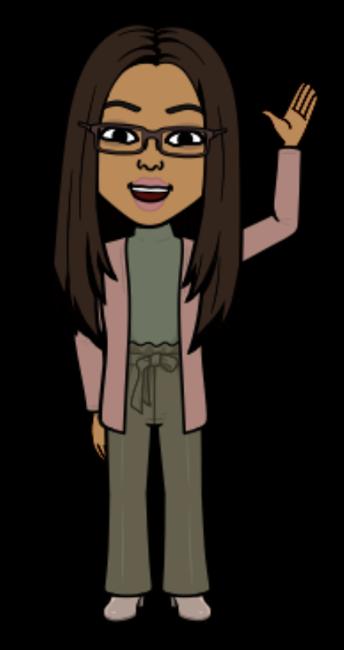
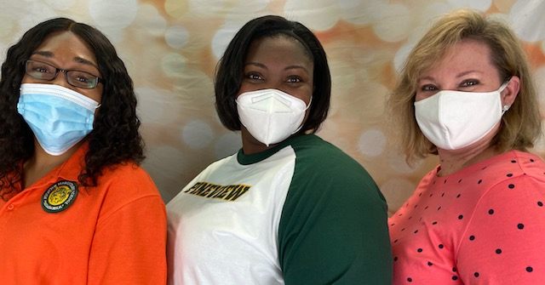
second Grade Teachers
Mrs. Miles
Ms. Hirst
Ms. Gray

Slide 3
communication
REMIND
Remind 101 is a text reminder application that allows the teachers to send out classroom and school reminders via text message. We can send out reminders to all of our parents at once, or individual texts. This allows you to easily communicate back with us. Remind helps us to keep a strong home-school connection. Please download the app.
EMAIL SCHOOL PHONE NUMBER: 850-488-2819
Grayc@leonschools.net Remind Code: @g37ga4
Hirstj@leonschools.net Remind Code: @edc4d9
Milesc@leonschools.net Remind Code: @miles20-21

Slide 4
transportation
Please make sure to tell your child’s teacher how they will be going home on the first day of school, and how they will typically go home(if different than the first day).
All transportation changes need to be sent in or arranged prior to 2:00 pm. You can either write a note or call the school.
Please do Not send emails or Remind messages changing transportation. We are not always able to see these in time for the end of the day, and we want all our Jaguars to go home the correct way.

Slide 5
schedule
8:15 – 8:25 Morning News & Harmony
8:25 – 9:25 Small Group Reading
9:25 – 9:55 D.O.L./Vocabulary
10:00 – 10:50 Whole Group Reading
10:50 – 11:30 Special Area
11:30 – 11:55 Lunch
11:55 – 12:25 Writing/Science
12:25 – 12:55 Lab
12:55 – 1:15 Recess
1:15 – 2:50 Math
2:50 Dismissal

Slide 6
Lunch/water bottles
Lunches will be bagged lunch only. Students will have their own individual tables to each lunch in the cafeteria. Digital Academy students will still be able to receive breakfast and lunch through a drive thru service. More info to come!
Students will need a refillable water bottle to drink from at school. They will only be able to use the sinks to refill their water bottles, not to drink from.

Slide 7
2nd Grade Website
Please visit our website often to help enhance your child’s learning and keep you updated and informed.
http://www.leonschools.net/pineview

